Slide 1
MUTHURANGAM GOVERNMENT ARTS COLLEGE (A)

Slide 2
PROPERTY MANAGEMENT USING SALESFORCE
Submitted by
Team Leader : Tamilarasan S
Team Member : Sridhar H
Team Member : Suriya P
Team Member : Venkatesan N
Team Member : Vinoth kumar R

Slide 3
CONTENT;
MILESTONE 1
1. Creation of Developer org.
2. Account activation.
MILESTONE 2
1.OBJECT
Buy,Rent,Loan
MILESTONE 3;TAB
Buy,Rent,Loan
MILESTONE 5;FIELDS
Object Buy,Field for Rent,Field for Rent
MILESTONE 6
1.Profiles
2.Marketing
MILESTONE 7
User
MILESTONE 8
Permissions Sets
MILESTONE 9
OWD Settings
MILESTONE 10
Reports
MILESTONE 11
Dashboards

Slide 4
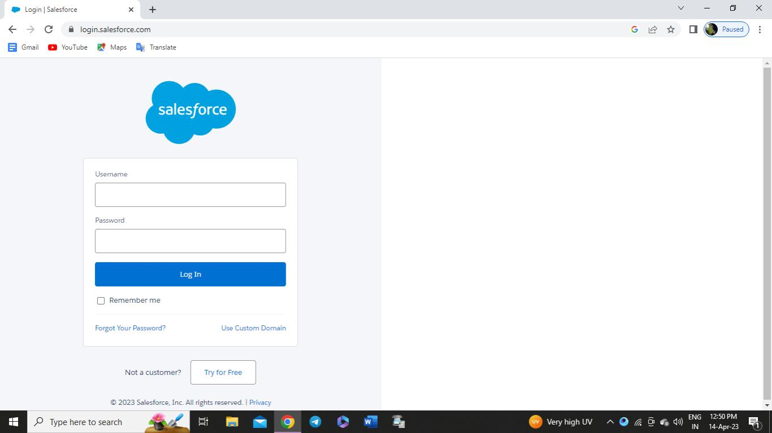
MILESTONE-1:
Creating developer account:
1. Go to developers.salesforce.com
2. Click on sign up.
3. Enter the username and password that you
just created.

Slide 5
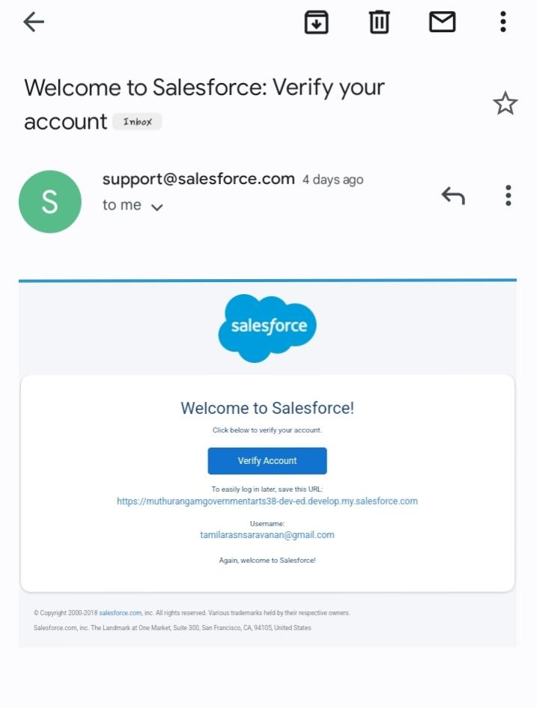
ACCOUNT ACTIVATION:
Go to the inbox of the email
that you used while signing up.
Click on the verify account
toactivate your account.

Slide 6
Milestone 2- Object
What Is Object?
Salesforce objects are database tables that permit you to store data that is specific to an organization.
What are the types of Salesforce objects
Salesforce objects are of two types:
● Standard Objects: Standard objects are the kind of objects that are provided by
salesforce.com such as users, contracts, reports, dashboards, etc.
● Custom Objects: Custom objects are those objects that are created by users. They supply
information that is unique and essential to their organization. They are the heart of any
application and provide a structure for sharing data.

Slide 7
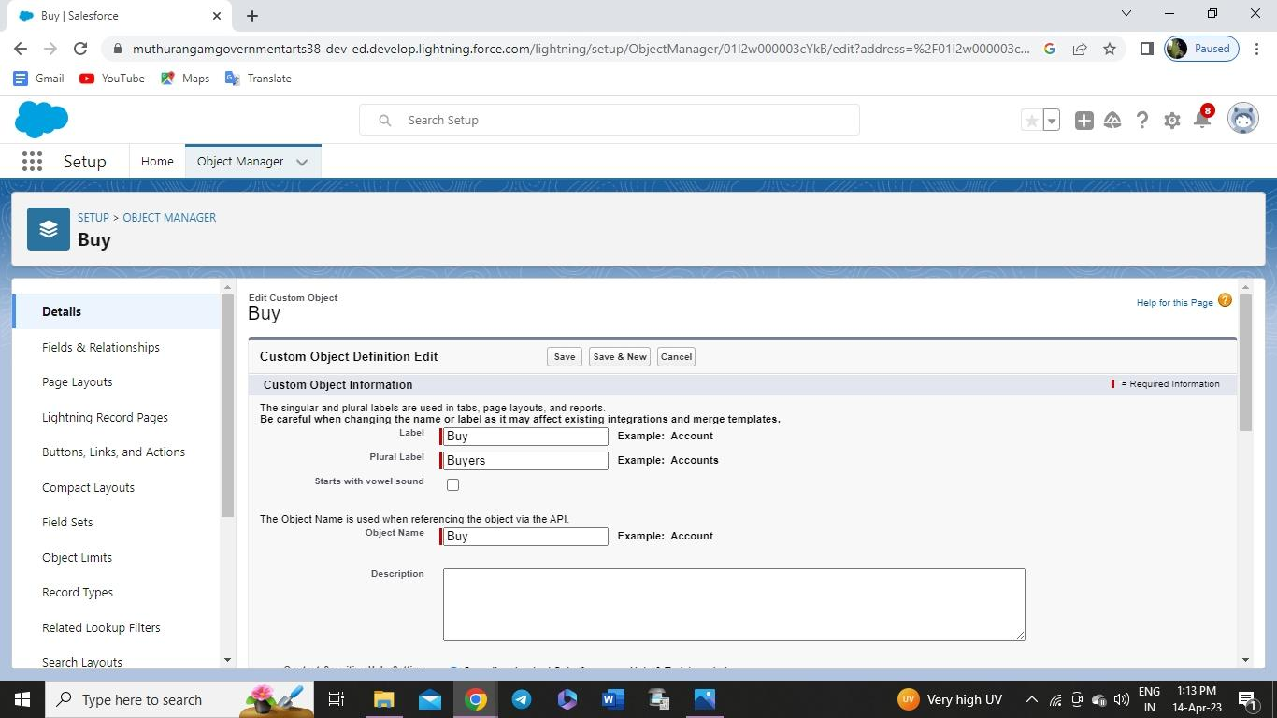
Milestone 2- Object
Create Object Buy
1. To create an object:
2. From the setup page → Click on Object Manager → Click on Create → Click on Custom
Object.
3. Enter the label name→Buy
4. plural label name→ Buyers
5. click on Allow reports,
6. Allow search → Save

Slide 8

Create Object Rent
1. To create an object:
2. From the setup page → Click on Object Manager → Click on Create → Click on Custom
Object.
3. Enter the label name→Rent
4. plural label name→ Rents
5. click on Allow reports,
6. Allow search → Save

Slide 9

Create Object Loan
7. To create an object:
8. From the setup page → Click on Object Manager → Click on Create → Click on Custom
Object.
9. Enter the label name→Loan
10. plural label name→ Loans
11. click on Allow reports,
12.Allow search → Save

Slide 10
Milestone 3:Tab
What is Tab?
A tab is like a user interface that is used to build records for objects and to view the records in
the objects.
Types of Tab
● Custom object tab
● Web tab
● Visualforce tab

Slide 11
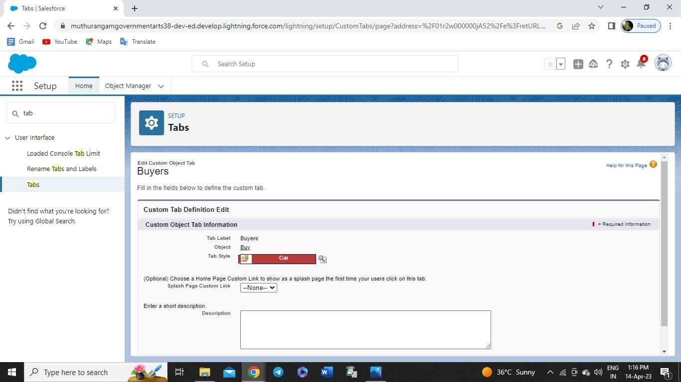
Milestone 3:Tab
To create a Tab:(Buy)
1. Go to setup page → type Tabs in Quick Find bar → click on tabs → New (under custom
object tab)
2. Select Object(Buy) → Select the tab style → Next (Add to profiles page) keep it as
default → Next (Add to Custom App) keep it as default → Save.

Slide 12
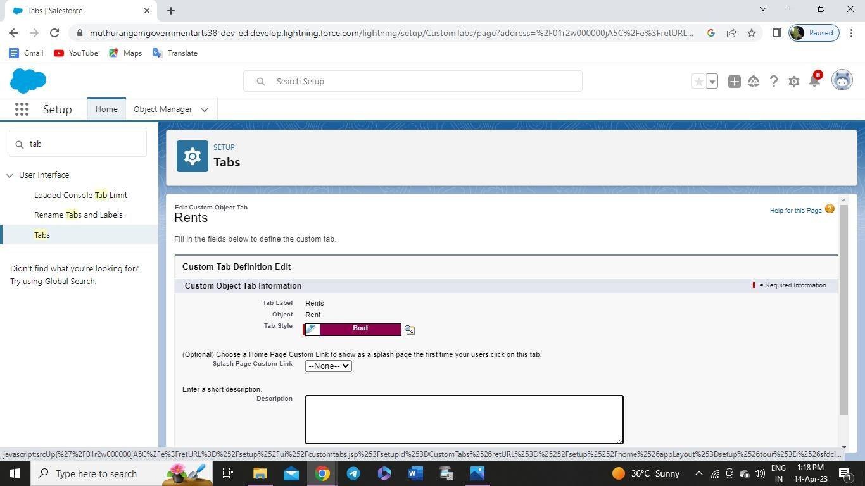
To create a Tab:(Rent)
1. Go to setup page → type Tabs in Quick Find bar → click on tabs → New (under custom
object tab)
2. Select Object(Rent) → Select the tab style → Next (Add to profiles page) keep it as
default → Next (Add to Custom App) keep it as default → Save

Slide 13
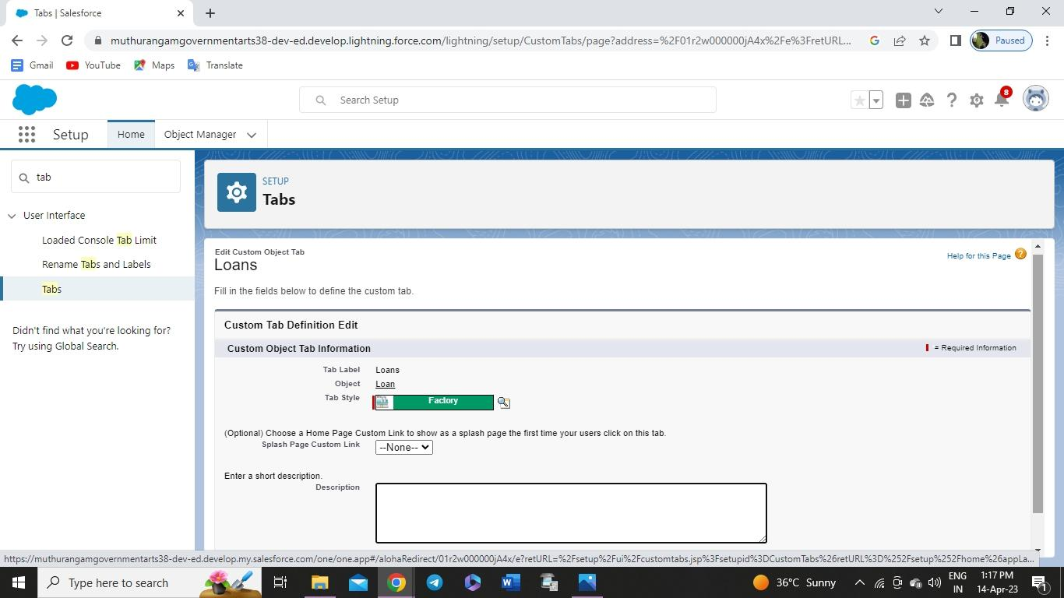
To create a Tab:(Loan)
1. Go to setup page → type Tabs in Quick Find bar → click on tabs → New (under custom
object tab)
2. Select Object(Buy) → Select the tab style → Next (Add to profiles page) keep it as
default → Next (Add to Custom App) keep it as default → Save

Slide 14
Milestone 4- The Lightning App:
An app is a collection of items that work together to serve a particular function. In Lightning
Experience, Lightning apps give your users access to sets of objects, tabs, and other items all in
one convenient bundle in the navigation bar.
Lightning apps let you brand your apps with a custom color and logo. You can even include a
utility bar and Lightning page tabs in your Lightning app. Members of your org can work more
efficiently by easily switching between apps.

Slide 15
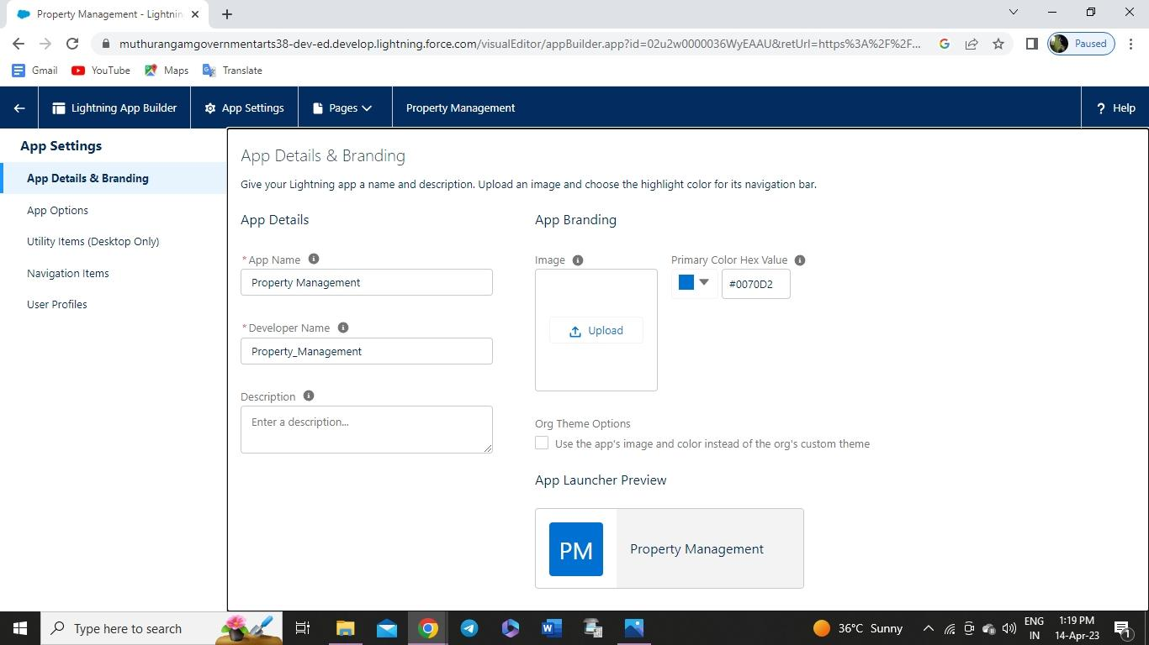
Milestone 4- The Lightning App:
Create the Lightning App
1. Go to setup page → search “app manager” in quick find → select “app manager” → click
on New lightning App.
Fill the app name as an Property Management in app details and branding →Next →
(App option page) keep it as default → Next
3. (Utility Items) keep it as default → Next → (Add Navigation Items)(add tabs Lead, Buy,
Rent, Loan) → Next → (Add User Profile) Add System Administrator, Salesforce
platform user, Standard User → Next.

Slide 16
Milestone5-Fields
When we talk about Salesforce, Fields represent the data stored in the columns of a relational
database. It can also hold any valuable information that you require for a specific object. Hence,
the overall searching, deletion, and editing of the records become simpler and quicker.
Types of Fields
● Standard Fields
● Custom Fields

Slide 17
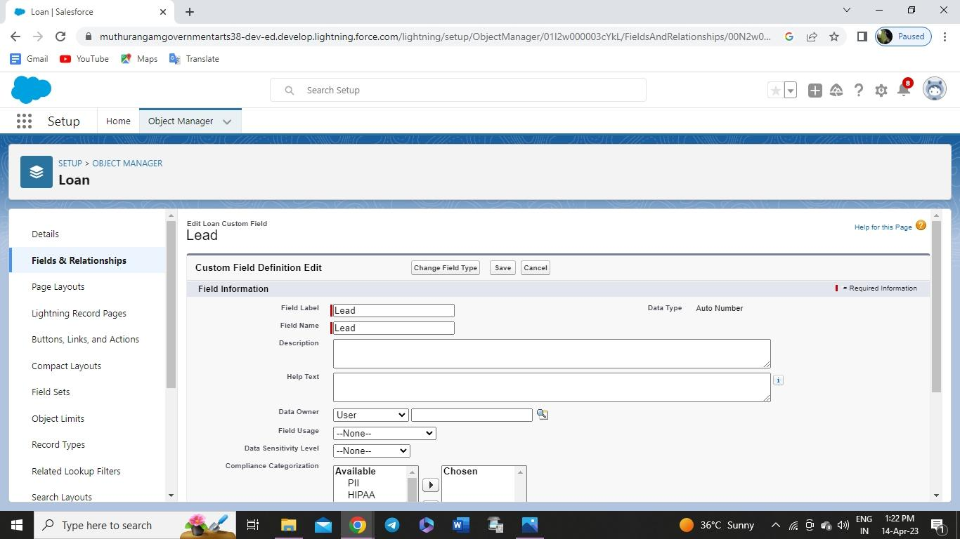
Milestone5-Fields
Create the Lead Field
1. Go to setup → click on Object Manager → type object name in search bar → click on the
object
.
2. Now click on “Fields & Relationships ” → New.
3. Fill the field label name Lead → Next → Next → Save.

Slide 18
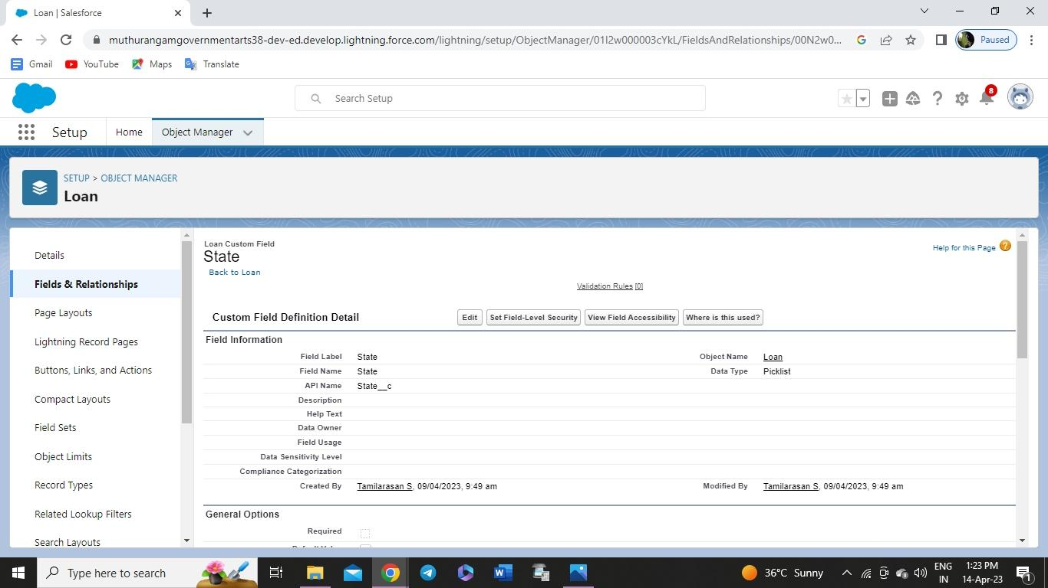
State: Create the Picklist Field (Maharashtra, Gujarat, Rajasthan)(Field Dependency)

Slide 19

City:Create the Picklist(Mumbai, Pune, Nashik)(Field Dependency)

Slide 20
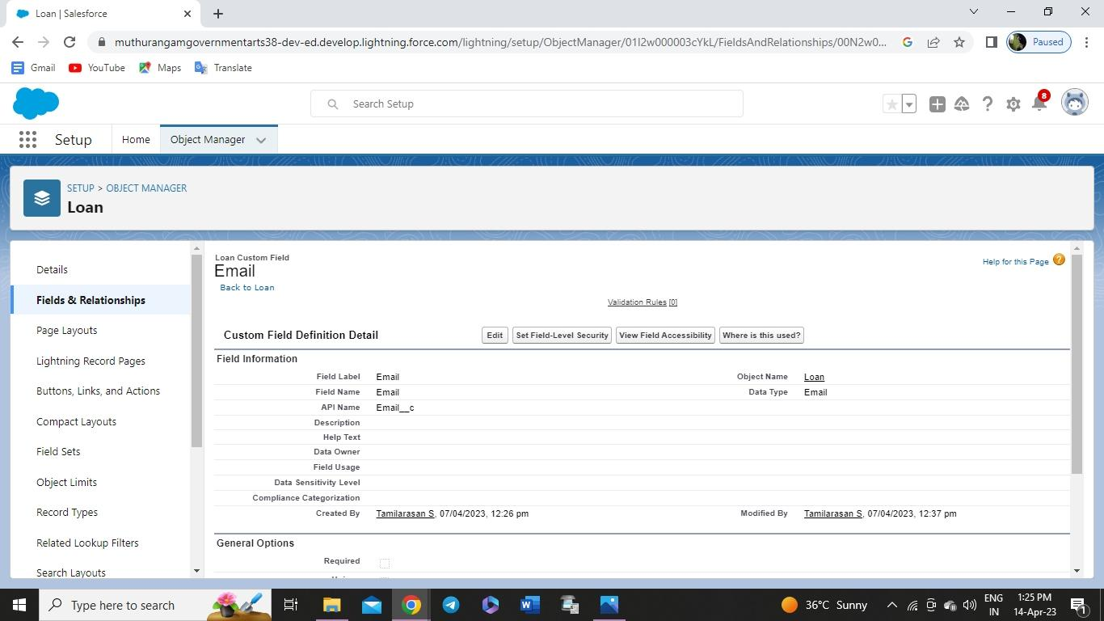
Email: Create the Email Select the Data Type As Email (Email)

Slide 21
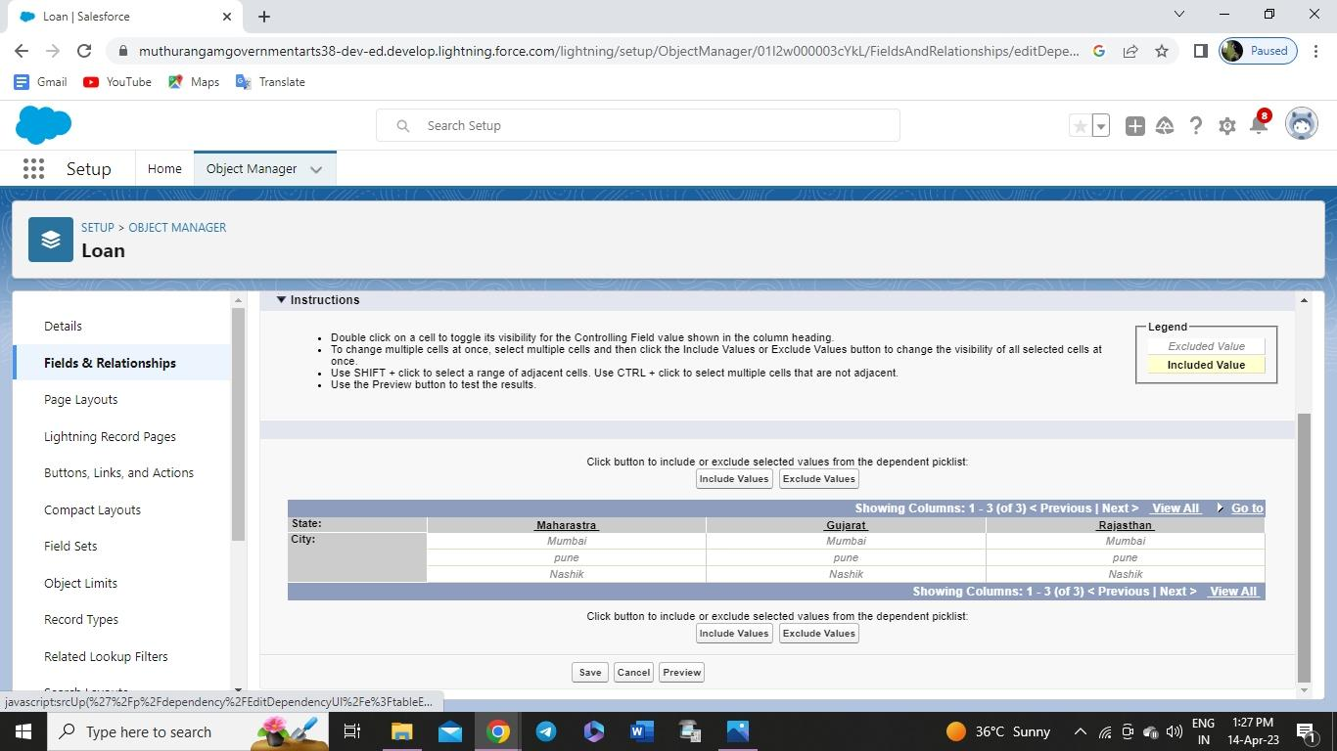
In the Fields and Relationship go to the Field Dependencies

Slide 22
For Object Buy
1. Create Field for Buy
2. Create Property Type: (Picklist) (Residential, Commercial, Industrial)
3. Discount:(Percentage As the Field Data Type)
4. State:Create the Picklist Field (Maharashtra, Gujarat, Rajasthan)(Field Dependency)
5. City:(Take Any City for Field Dependency

Slide 23
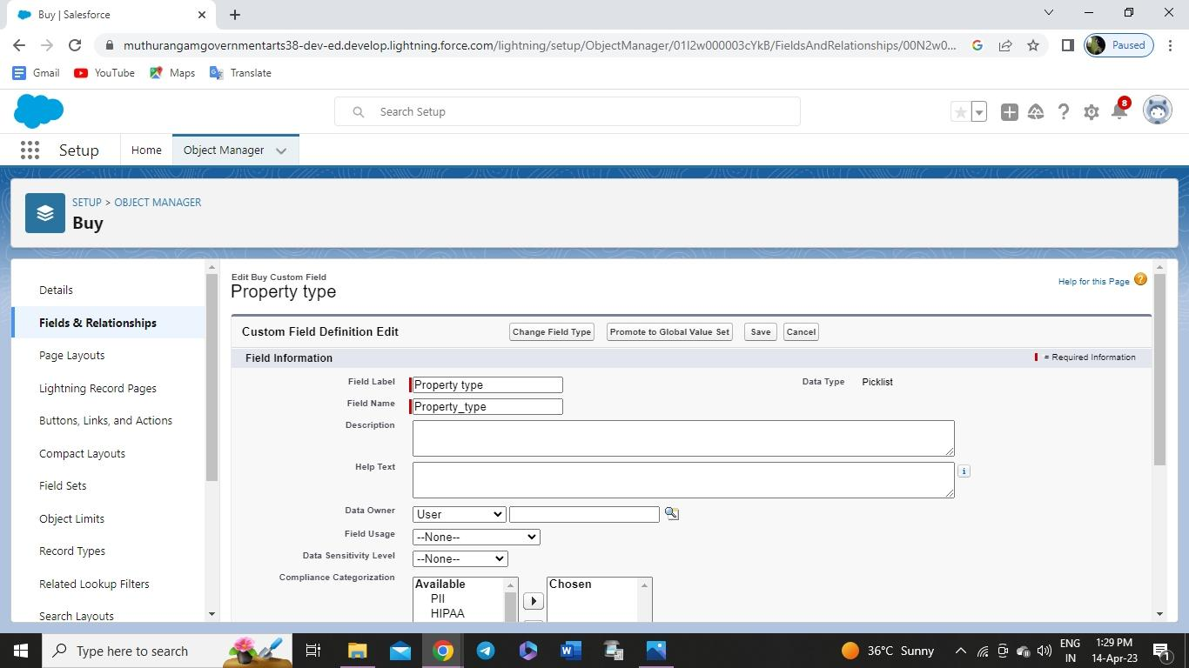
Create Property Type: (Picklist) (Residential, Commercial, Industrial)

Slide 24
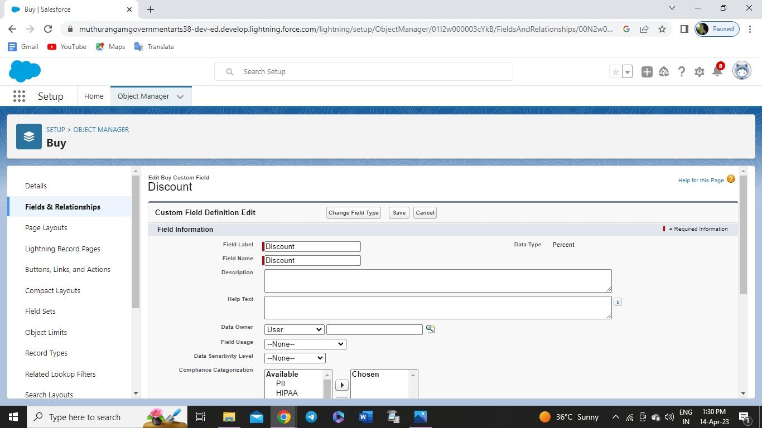
Discount:(Percentage As the Field Data Type)

Slide 25
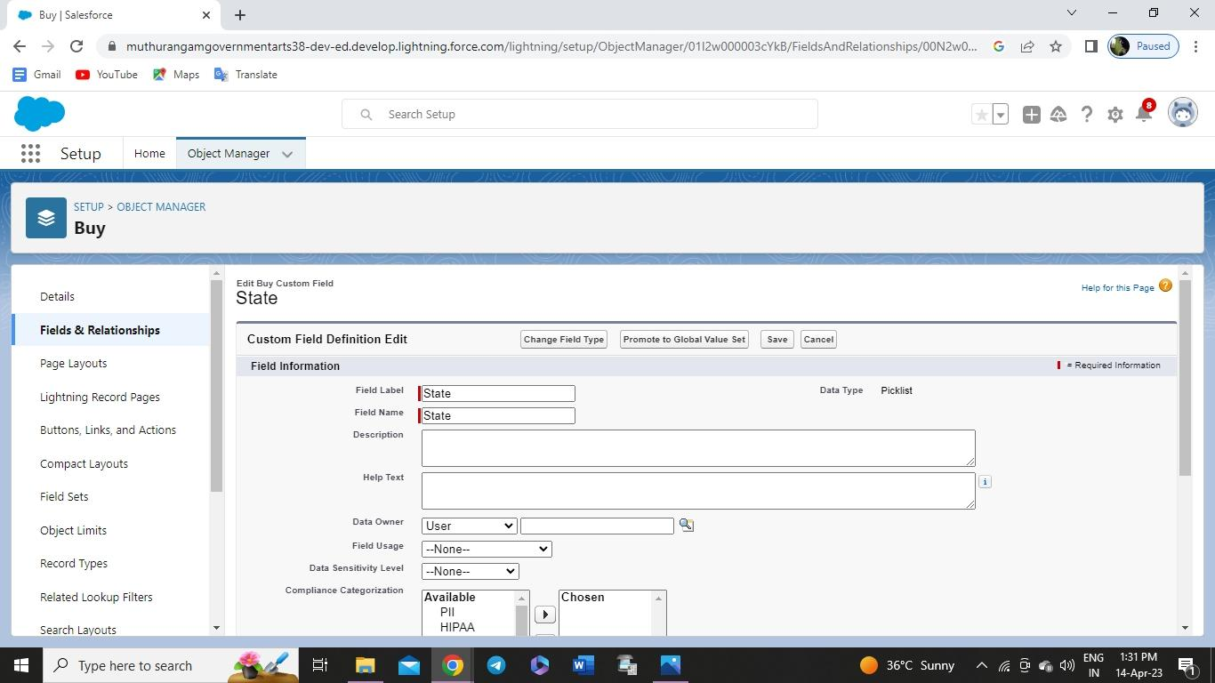
State:Create the Picklist Field (Maharashtra, Gujarat, Rajasthan)(Field Dependency)

Slide 26

City:(Take Any City for Field Dependency)

Slide 27
Create Field for Rent
1. Rent:(Auto Number while Creating the object)→ R-{0000}
2. Rental City:Select the Text as the Field Data Name(Any City)
3. BHK type:(Picklist) (1BHK, 2BHK,3BHK)

Slide 28

BHK type:(Picklist) (1BHK, 2BHK,3BHK)

Slide 29
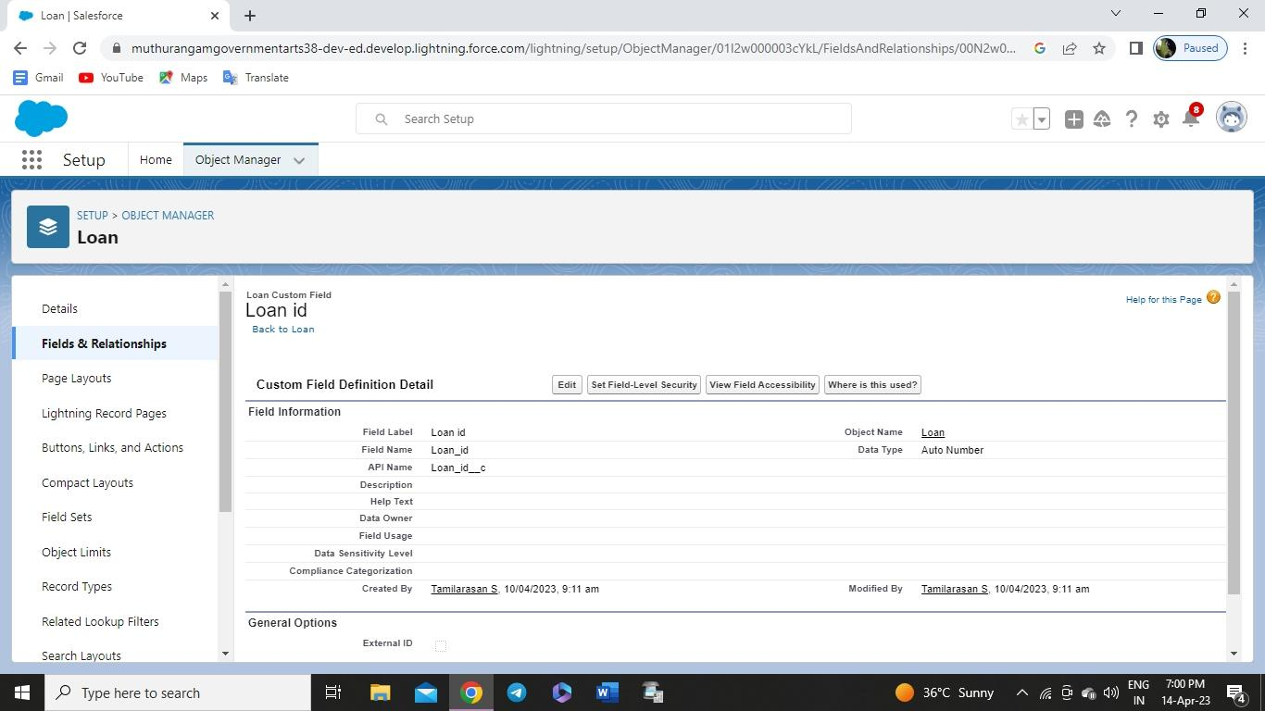
Create Field for Loan
1. Loan Id: Auto generated Field Take it as Autonumber LN-{0000}

Slide 30
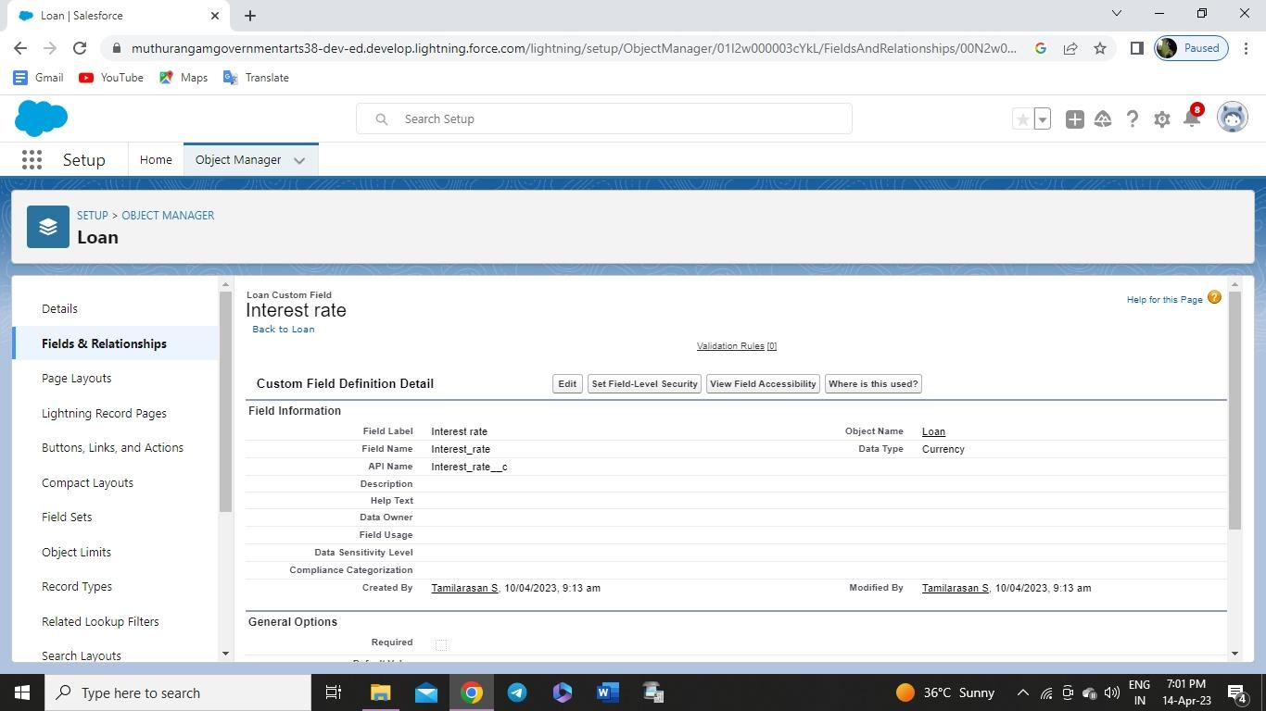
2. Interest Rate: (Select the Field Data Type As Currency)

Slide 31
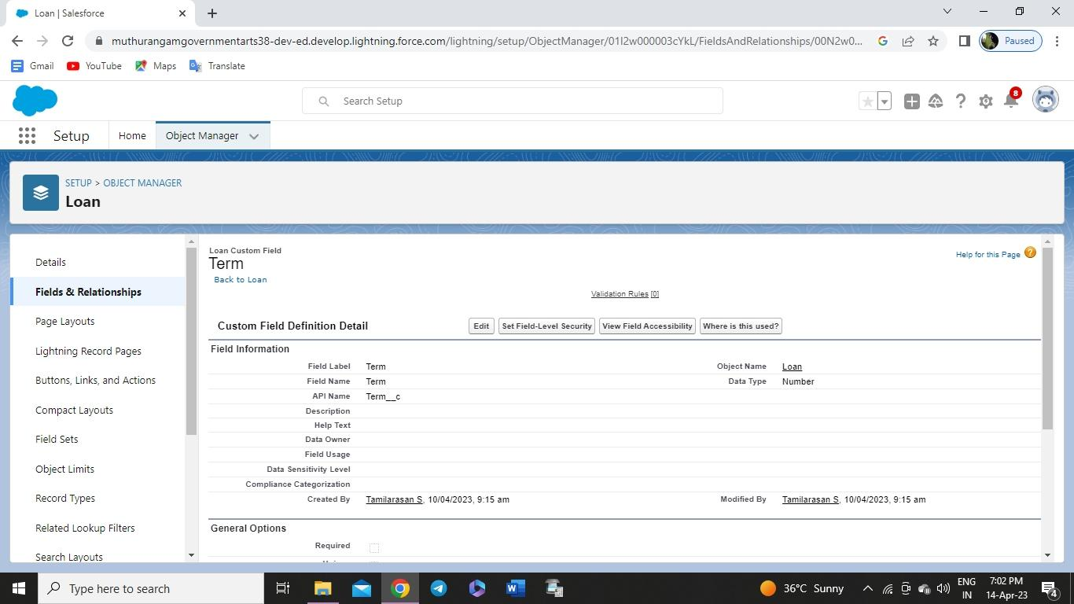
3. Term:(Select the Field Data type as Number)

Slide 32

4. Annual Loan Field create the Number as the field data type

Slide 33

5. Total Loan Instalments:( Field create the Number as the field data type)

Slide 34

6. Loan Repayment( Field create the Number as the field data type)

Slide 35

7. Loan Amoun( Select the Field data type as Formula)

Slide 36
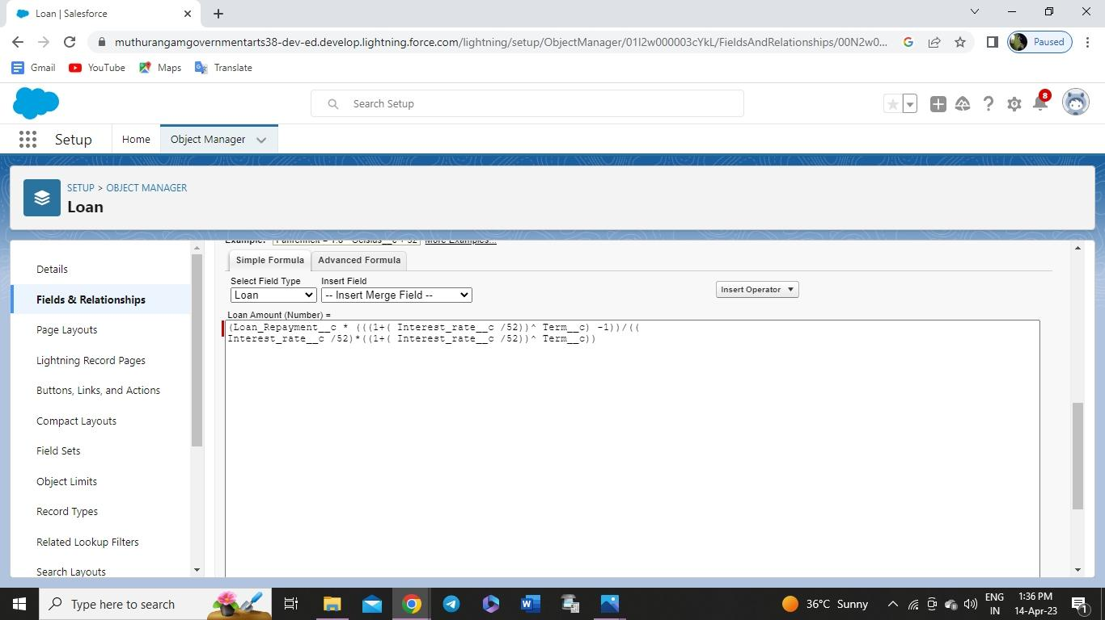
For the Loan Object→ Go to the fields and Relationship and select the formula in
field data type. In Formula option select Advanced Formula and write the following
formula

Slide 37
Milestone 6: Profile
A profile is a group/collection of settings and permissions that define what a user can do
in salesforce.
● profile controls “Object permissions, Field permissions, User permissions, Tab settings,
App settings, Apex class access, Visualforce page access, Page layouts, Record Types,
Login hours & Login IP ranges.
● You can define profiles by the user's job function. For example System Administrator,
Developer, Sales Representative.

Slide 38
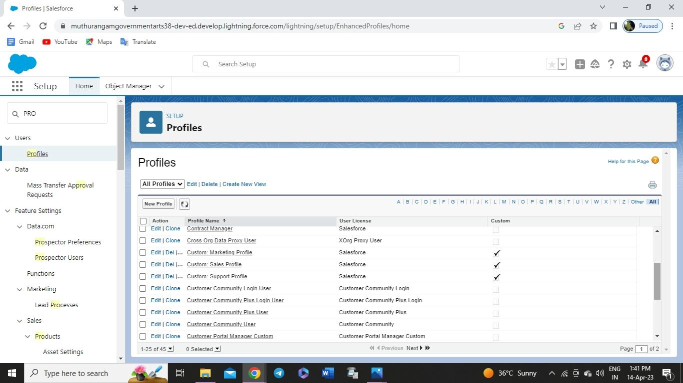
To create a new profile:
1. Go to setup → type profiles in quick find box → click on profiles → clone the desired
profile (standard user is preferable) → enter profile name → save

Slide 39
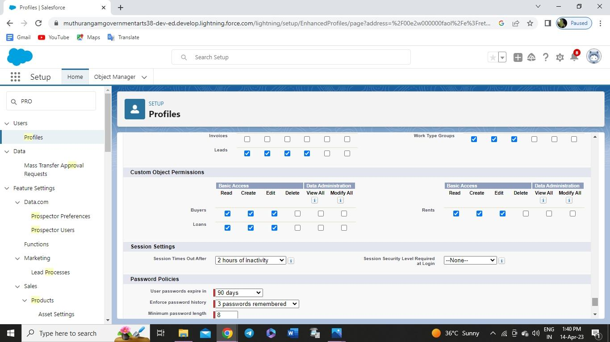
Scroll down to Custom Object Permissions and Give view all access permissions and assign
to the parent profile

Slide 40
Milestone7-New User
● A user is anyone who logs in to Salesforce. Users are employees at your company, such
as sales reps, managers, and IT specialists, who need access to the company's records.
● Every user in Salesforce has a user account. The user account identifies the user, and the
user account settings determine what features and records the user can access.

Slide 41
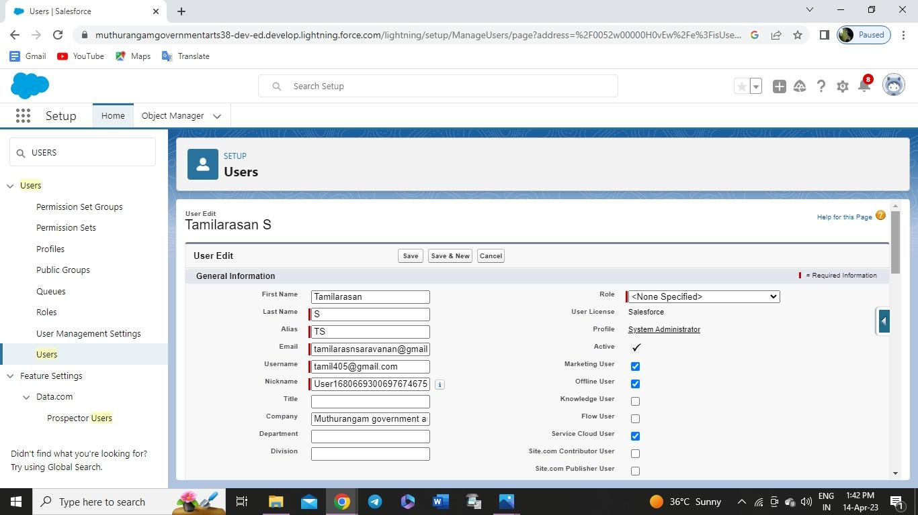
Create User
1. Go to setup → type users in quick find box → select users → click New user.
Fill in the fields (first name, last name, alias, email id, username, nick name, role, user
license, profiles) → save.

Slide 42
Milestone8-Permission Set
A permission set is a collection of settings and permissions that give users access to various tools
and functions. Permission sets extend users' functional access without changing their profiles.
Users can have only one profile but, depending on the Salesforce edition, they can have multiple
permission sets.

Slide 43
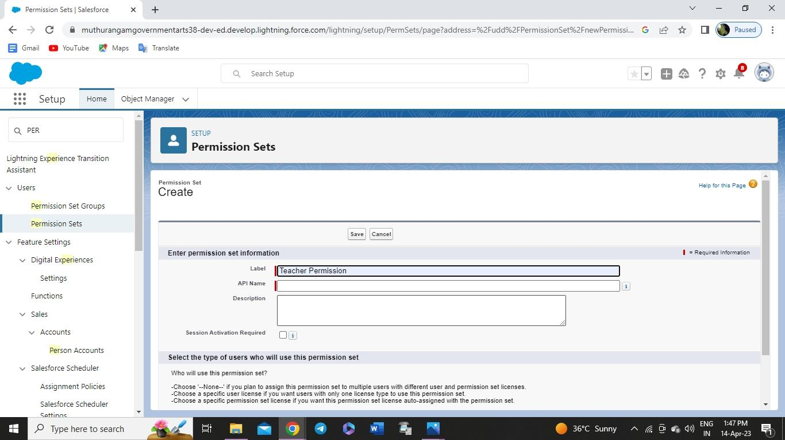
Create the Permission Sets
1. Go to setup → type “permission sets” in quick search → select permission sets → New.
2. Enter the label name → save.
3. After saving the permission click on the Manage assignment

Slide 44
Milestone 9: Setup For OWD
Organization-Wide Defaults, or OWDs, are the pattern security rules that you can follow for your
Salesforce instance. Organization Wide Defaults are utilized to confine who can access what
information in your CRM. You can award access through different methods that we will discuss
later (sharing principles, Role Hierarchy, Sales Teams, and Account groups, manual sharing, and
so forth).
Primarily, there are four levels of access that can be set in Salesforce OWD and they are-
● Public Read/Write/Transfer (only available of Leads and Cases)
● Public Read/Write
● Public Read/Only
● Private

Slide 45
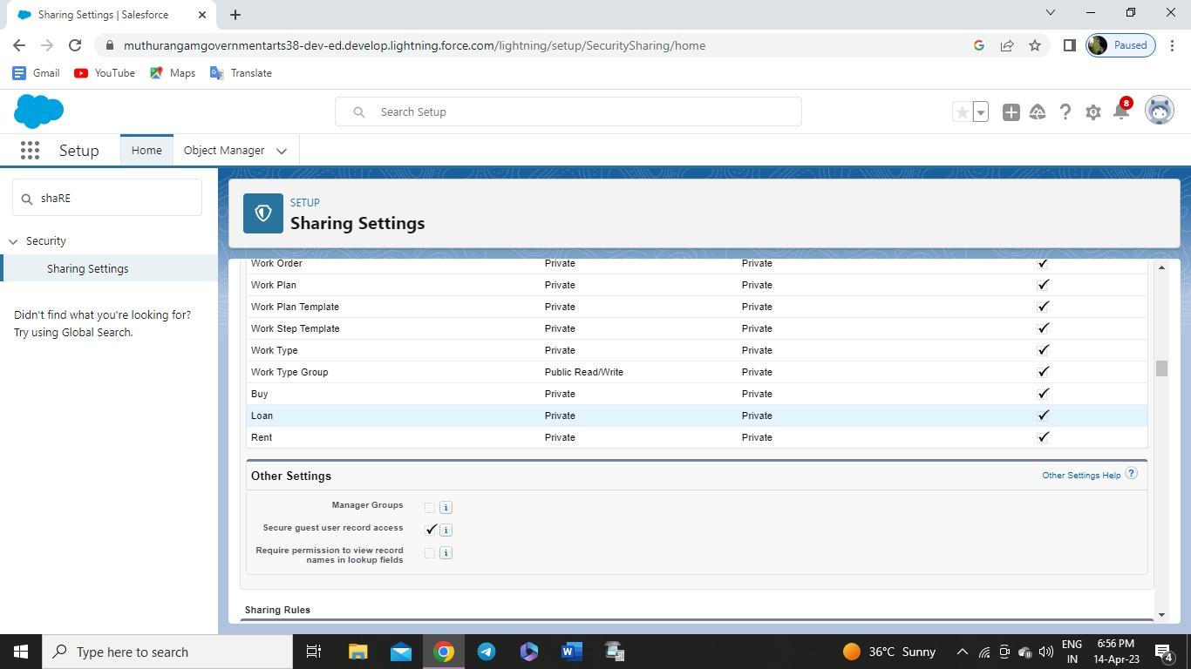
Create OWD Setting
1. Setup, use the Quick Find box to find Sharing Settings.
2. Click Edit in the Organization-Wide Defaults area.
3. For each object, select the default access you want to give everyone.
4. To disable automatic access using your hierarchies, deselect Grant Access Using
Hierarchies for Lead, Rent custom object
5. Click Edit and from the Drop Down select private for internal and external

Slide 46
Milestone10-Report
Reports give you access to your Salesforce data. You can examine your Salesforce data in almost
infinite combinations, display it in easy-to-understand formats, and share the resulting insights
with others. Before building, reading, and sharing reports, review these reporting basics.
Types of Reports in Salesforce
Tabular
Summary
Matrix
Joined Reports

Slide 47
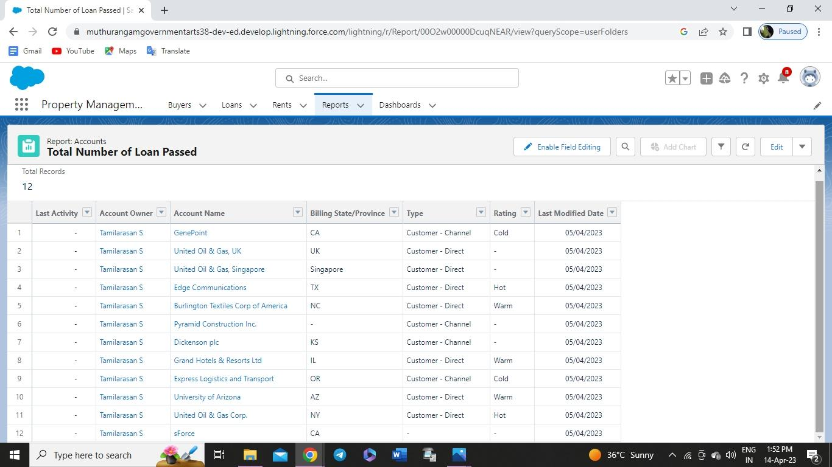
Create Report-
1. Go to the app → click on the reports tab
2. Click New Report
3. Select report type from category or from report type panel or from search panel → click
on start report.
4. Customize your report, then save or run it.
Create Report for following Condition
1. Create the Report of the Total Number of Loan Passed for for getting the Amount For the
Property
2. The Condition should be Like Loan Amount >= to 5000$

Slide 48
Milestone11-Dashboards
Dashboards help you visually understand changing business conditions so you can make
decisions based on the real-time data you’ve gathered with reports. Use dashboards to help users
identify trends, sort out quantities, and measure the impact of their activities. Before building,
reading, and sharing dashboards, review these dashboard basics.

Slide 49
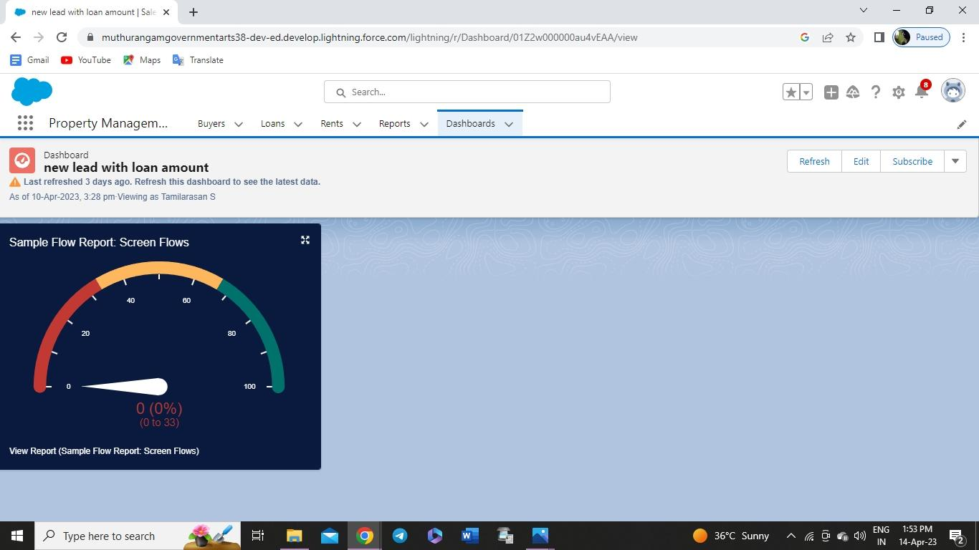
Create dashboards
1. Go to the App Launcher and select the Dashboards
2. Select add component
3. Select the folder select the following option new lead with loan Amount
4. Select in which format you want display chart
Create Dashboard
1. Create the Dashboard for the Same Take Any Type of Dashboard( Chart) And Display It
on The App Home Page

